Slide 1


Crop and Fertilizer Recommendation Using Machine Learning
Presented by Sameera Raghavendra Suanand( B-tech in AIML 4th semester)
AICTE Internship Student Registration ID : STU66a1d9f7140d51721883127

Slide 2

Learning Objectives
Understanding the role of Machine learning in agriculture, specifically about crop and fertilizer recommendation.
Build a solid base of understanding on core ML concepts, through hands on practice with jupyter Notebook and Python libraries.
Understanding the importance of ethics in AI in order to ensure fairness, transparency and overall responsible tech use.
Gaining practical experience on training models for real-world agri-data.
Collaboration and the sharing of work using platforms like GitHub
GOAL
Source :
www.freepik.com/

Slide 3
Methodology
Data Collection and preparation:
Gather real-world crop and soil data
Remove missing values and correct inconsistencies
Supervised Learning approach:
Using labeled data , input features being eg: soil type, rainfall and the target being the recommended crop or fertilizer.
Feature Selection:
We have to choose relevant and practical features.
Ensure the features are robust to noise and easy collect in real life.
Algorithm Selection:
Choose appropriate algorithm based on data size and problem complexity.
For my model I have used decision trees for their interpretability and fast performance.
Training:
The model was trained using train_test_split from sklearn.model_selection library.
This model was trained in order to learn mappings between the inputs (e.g soil conditions, weather) and outputs (recommended crop/fertilizer).
Feature scaling and label encoding were applied before fitting the model.
Evaluation
Model performance was evaluated using an accuracy score.

Slide 4
Tools and Technology used
Python:
Python was the main programming language which was used.
Python was used mainly because it is easy to read and is powerful for data analysis and Machine Learning.
Jupyter Notebook:
Jupyter Notebook was my interactive coding environment.
It has proven to be perfect for testing the code,visualizing data and also documenting my work.
Python Libraries:
Pandas: For handling and analyzing data
NumPy – For numerical computations
Sckit-learn – for building and testing ML models, built on top of NumPy, SciPy and matplotlib.
Matplotlib and Seaborn: For visualizing the data and creating graphs.
Pickle: For saving our model after being trained and then loading the model after being retrained.
GitHub:
I used GitHub in order to share my work for evaluation and collaborate with others in order to gain their insights.

Slide 5
Problem Statement:
When it comes to mordern agriculture, our farmers often face difficulties in selecting the most suitable crop to prepare and also the most appropriate fertilizer based on their current soil, rainfall, PH, fertility etc.
These decisions when incorrect can lead to a reduced yield, increased costs and overall environmental degradation due to an overuse or sometimes even misuse of chemical fertilizers.
Our goal of this project was to develop a machine learning based recommendation system that can accurately predict:
The most optimal crop to grow based on parameters like N,P,K levels, Ph, temperature, humidity and rainfall.
The most suitable fertilizer for a particular crop based on the soil’s nutrient deficiencies.
By leveraging past agricultural data and machine learning, this system should help farmers and make data driven location-relevant decisions in order to boost yields, minimize waste and promote sustainable farming and green skills.

Slide 6
Solution:
Merging Green Skills and AI: By leveraging both green skills and AI we come to these steps in order to solve our problem statement…..
Data Acquision : Collect previous agricultural data with features like N,P,K levels , PH , temperature , humidity , rainfall, etc.
Data Preprocessing: In order to handle missing values and outliers.
Encode categorical features like the crop names using the LabelEncoder.
The numerical data is scaled using Standard Scaler.
Feature Selection: Retain features that actually impact the prediction and are feasible to collect in real-world conditions.
Train-Test Split: Splitting the dataset into training and testing modules using the train_test_split .
Building the model: Training the Decision tree model on the training data.
Evaluation: Testing the model using unseen data . Evaluate the performance using accuracy ,confusion matrix, etc.
Findings: By the end of our process we were able to achieve an overall accuracy of 98.49% with the crop recommendation model and 100% with respect to our Fertilizer recommendation model.
Link to the repository:
https://github.com/Danta110/Edunet-Foundation-/tree/main

Slide 7
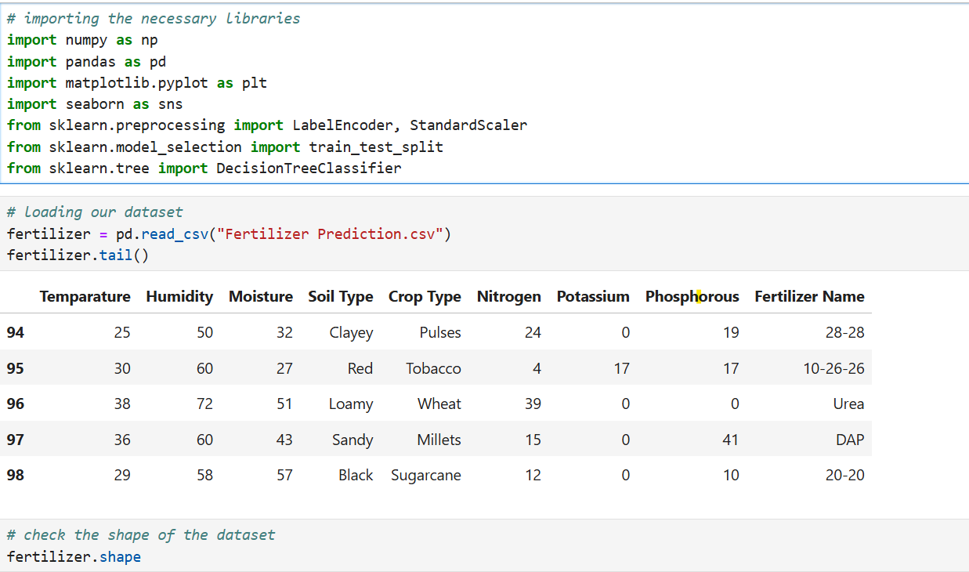
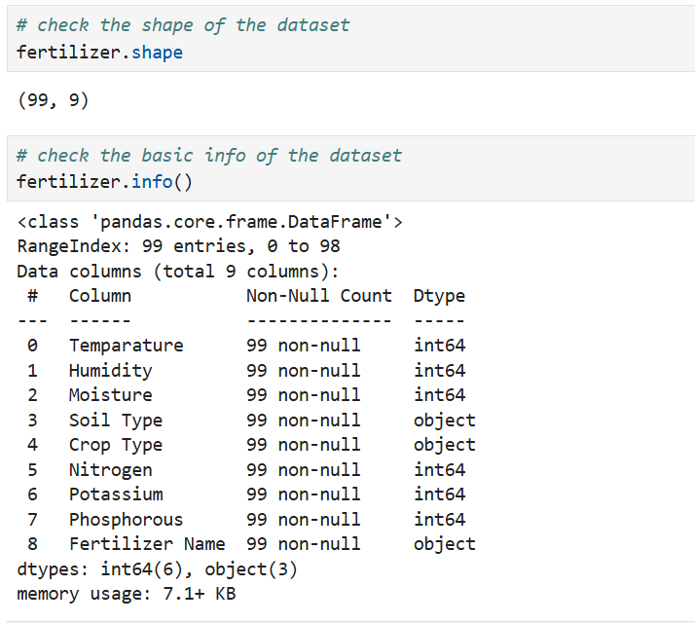
Screenshot of Output:
For the Feritilizer recommendation model
Checking the shape and basic info of the dataset
Importing the necessary libraries

Slide 8
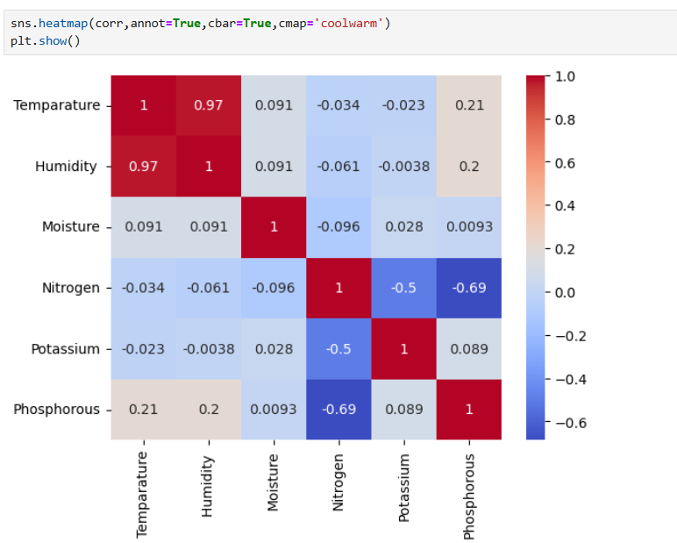
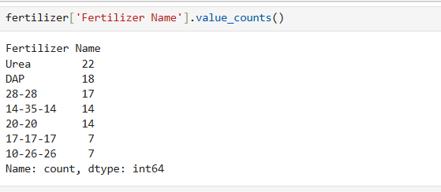
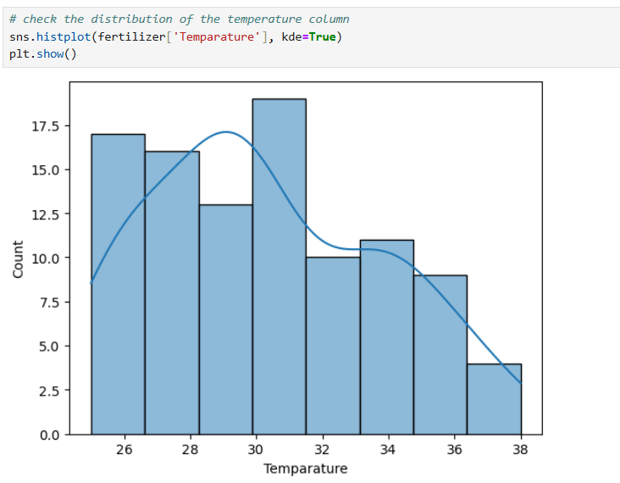
Screenshot of Output:
Counts for each fertilizer
Data visualization using the seaborn library

Slide 9
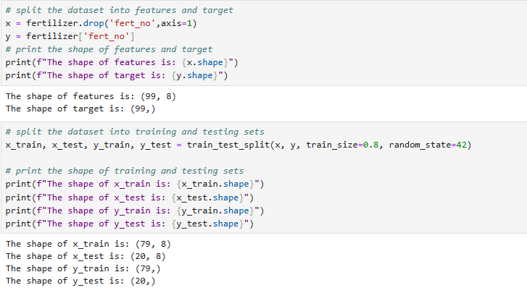
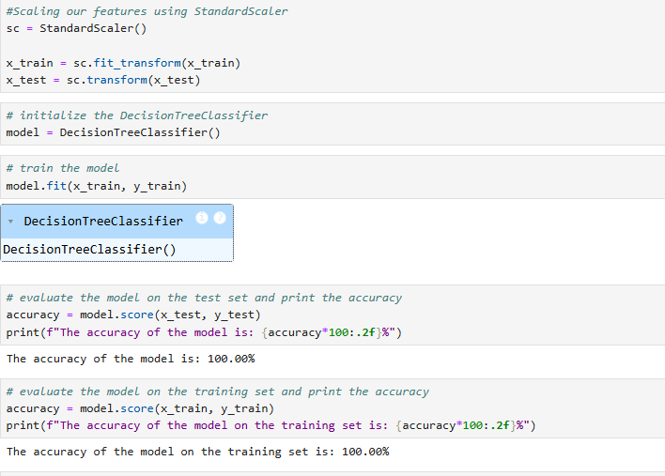
Screenshot of Output:
Spliting the dataset into testing and training
Calculating the accuracy score

Slide 10
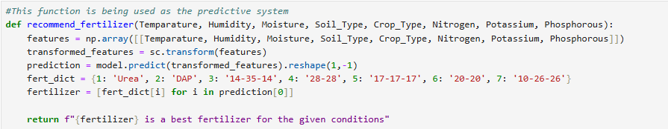
Screenshot of Output:
This function returns a fertilizer based on environmental and crop conditions using the trained model .

Slide 11
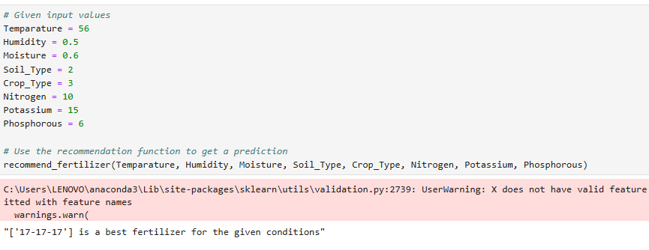
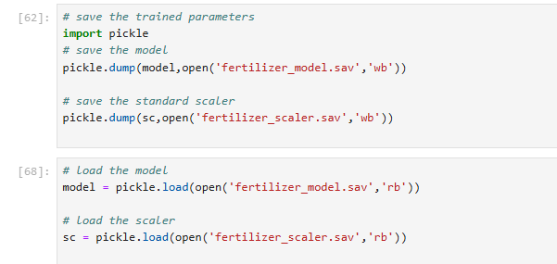
Screenshot of Output:
Making a prediction for the fertilizer

Slide 12
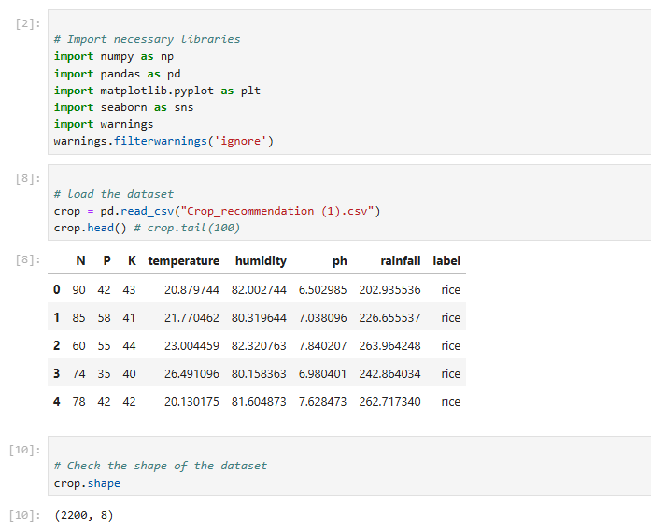
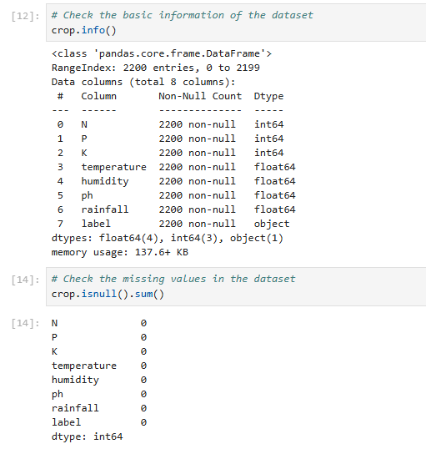
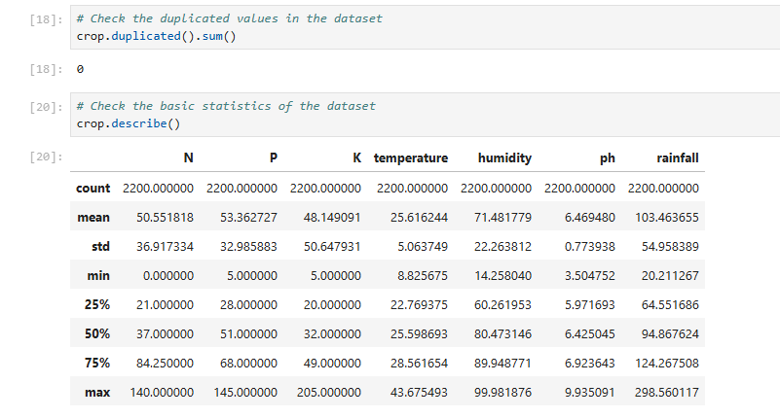
Screenshot of Output:
Importing the necessary libraries
Checking the shape and basic info of the dataset

Slide 13
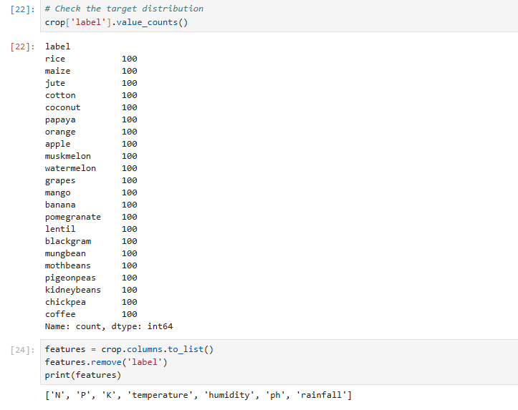
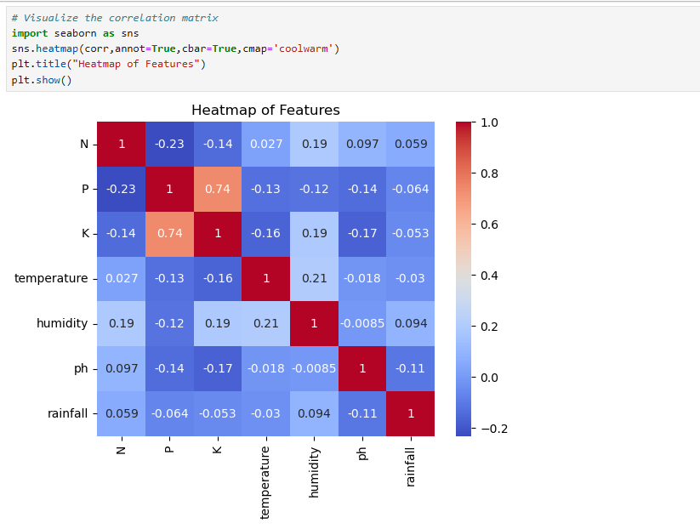
Screenshot of Output:
Using the seaborn library to visualize the data.

Slide 14
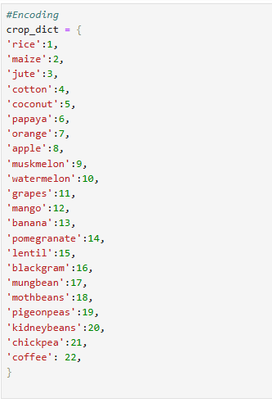
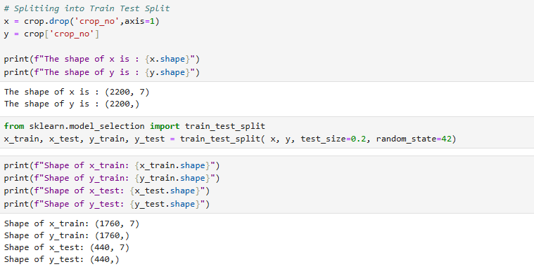
Screenshot of Output:
Printing out the shape of the testing split and training split.
Encoding the categorical data

Slide 15
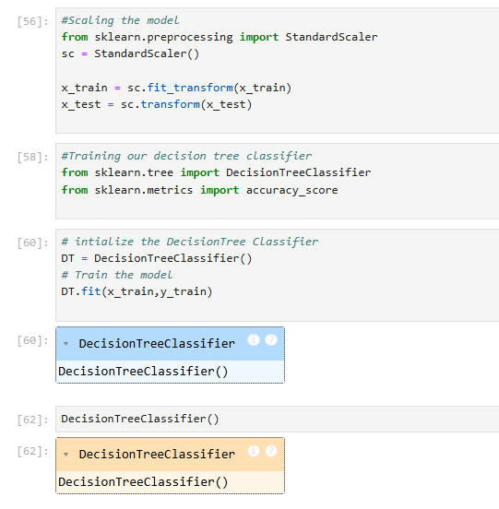
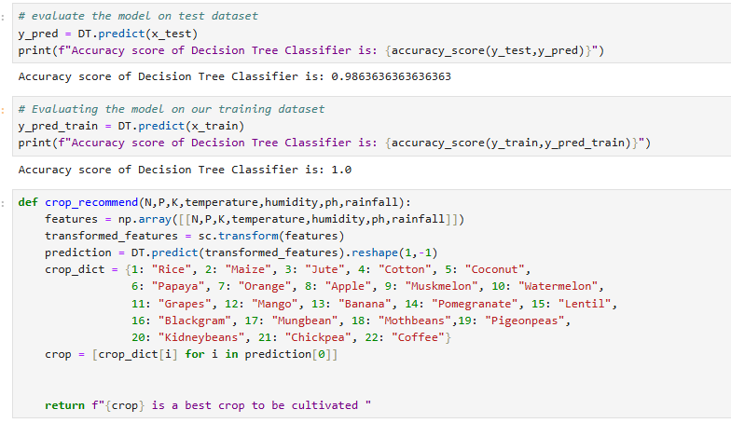
Screenshot of Output:

Slide 16
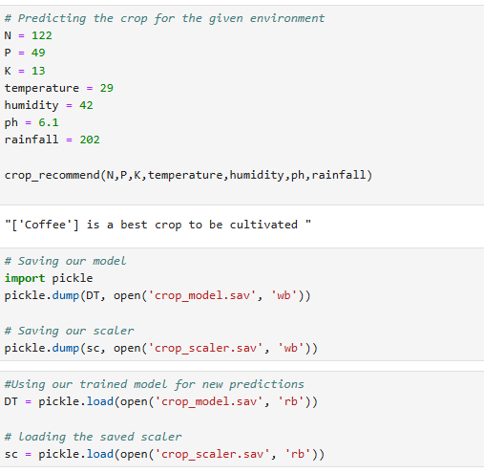
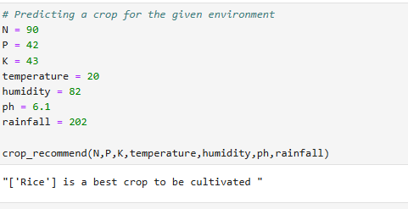
Screenshot of Output:
Making a prediction for crop

Slide 17
Conclusion:
Developed, tested and trained a crop recommendation system with 98.4% accuracy and a Fertilizer Recommendation System with an accuracy of 100% using a Decision Tree Classifier.
The Data was preprocessed effectively and relevant features like the soil type, crop type and nutrient levels in order to train the model.
Both the models can provide real-time recommendations based on environmental inputs.
Discussing a limitation:
A particular limitation is that the model may have a tendency to overfit.
In order to fix this we can use Random Forest methods for better generalization.
Future scope and improvements include:
We can use deep learning techniques like feedforward neural networks could be used to model more complex, non-linear relationships in larger scale datasets.
We could also use a larger dataset in order to make more accurate predictions and generalize better, which is the main goal of supervised learning at the end of the day.
My Learning:
Pursuing this project has enhanced my understanding of green skills and ML methods overall for me, Especially in areas of data preprocessing, model evaluation and data interpretation.

